Slide 1
When? How? and Where? – Detecting Diseases Outbreak through News
Saad Bendou, Sufyan Dahalan, Mohamad Almortada (BA) Supervisor: Terry Lima Ruas, Jan Philip Wahle Project NLP7 Kick-off Presentation

Slide 2


Motivation
BlueDot and Metabiota helped governments and institutes worldwide bring awareness that in turn aided earlier action to combat COVID-19¹.
06/05/2021

Slide 3
How can we to identify possible new outbreaks in their early stages?
Incorporate the new advances from NLP to build a system able to help detect possible future outbreaks to support public policies.
Tasks:
Providing Web crawler
Collection and organization of data
Big Data analysis/Data Analysis
06/05/2021
S. Bendou, S. Dahalan, M. Almortada - When? How? and Where? – Detecting Diseases Outbreak through News

Slide 4
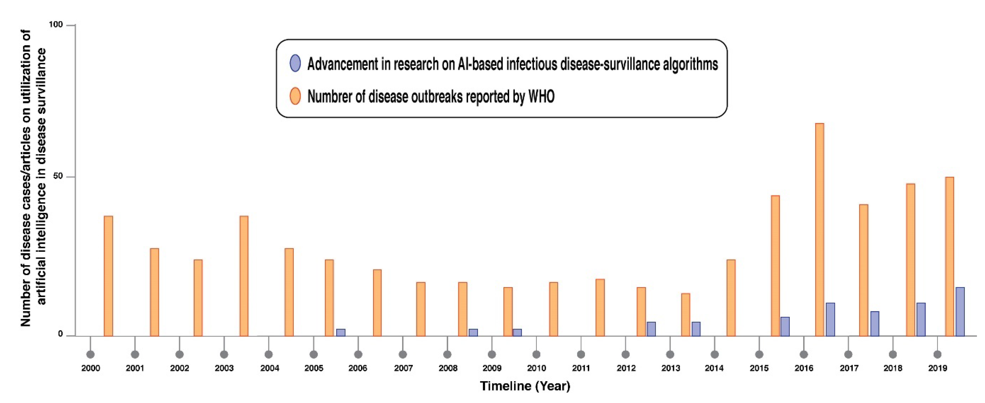
Related Work
BlueDot uses natural language processing and machine learning to track and locate infectious disease spread¹.
Figure 1: https://www.mdpi.com/2673-2688/1/2/9/htm
06/05/2021
S. Bendou, S. Dahalan, M. Almortada - When? How? and Where? – Detecting Diseases Outbreak through News

Slide 5
Conclusion
Explore and research more about the capabilities of such an approach to detecting viral outbreaks
Define specifications of the web crawler.
How will we realistically crawl the web and extract data
Anticipated challenges:
IP bans, Captch and Cloudflare
Data Analysis (later on)
Metric selection
Data storage
Data standardization
06/05/2021
S. Bendou, S. Dahalan, M. Almortada - When? How? and Where? – Detecting Diseases Outbreak through News

Slide 6
References
1: https://www.mdpi.com/2673-2688/1/2/9/htm
06/05/2021

Slide 7

Credits: https://www.memecreator.org/meme/any-questions96/
06/05/2021

